Slide 1
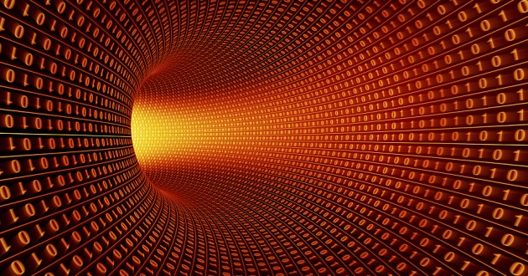
Quantum Computing
By: Avani Chandratre
Notes:
https://arxiv.org/pdf/1910.09930.pdf

Slide 2
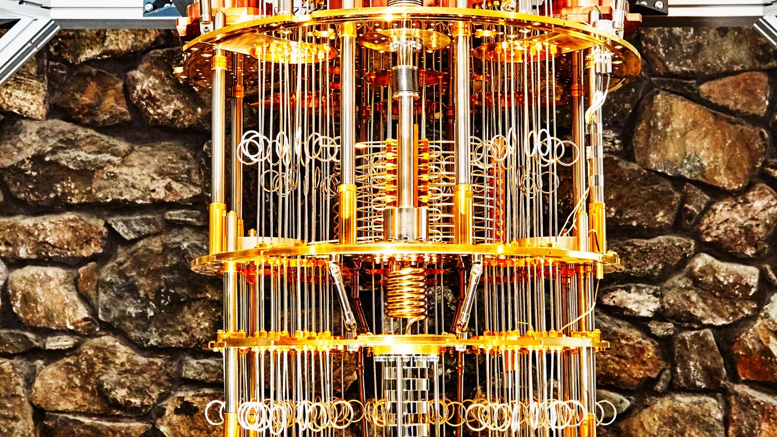
What is quantum computing?
Quantum computing, first introduced in the 1980s, is a way to tackle problems that are too complex for current technology. They operate using quantum bits or qubits.
Notes:
Conventional computer chips can only process so much information at one time and we’re coming very close to reaching their physical limits.

Slide 3
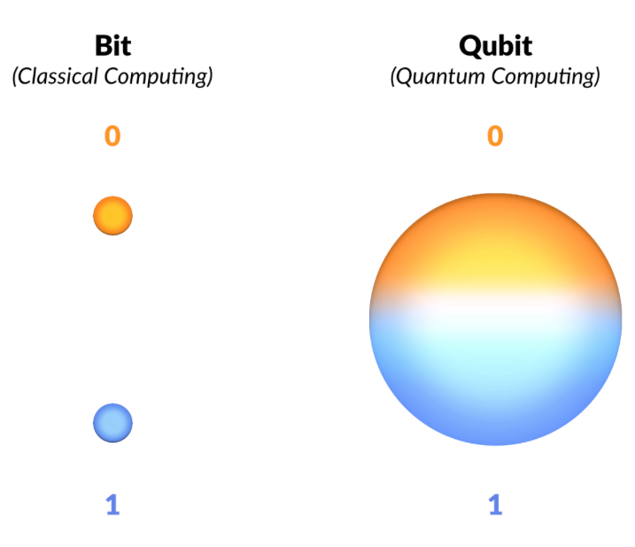
Qubits
Are the quantum version of bits.
Unlike traditional bits, qubits can be both 0 and 1 at the same time.
Qubits have relationships with other qubits that persist despite distance.
Are usually made of semiconductive materials
Notes:
Principle of Superposition or the paradoxical example of Schrodinger's Cat (the cat is both alive and dead at a given point in time)
Known as Entanglement, caused by the spinning of quantum particles.

Slide 4
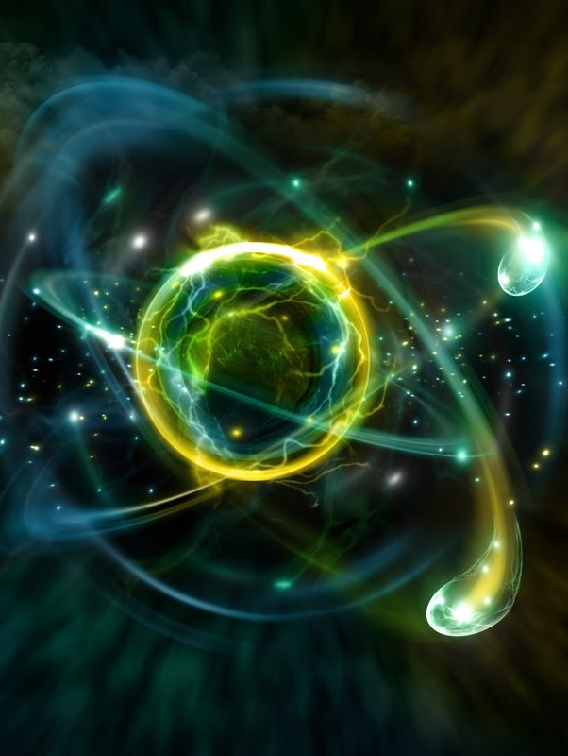
Using Quantum Properties
Electromagnetic waves and magnetic fields are used to manipulate electrons.
Qubits are sensitive to environmental factors.
Notes:
Biggest issue with quantum computing is persistence
Problem gets worse with more qubits. Current 50 need hundreds/thousands to solve the problems

Slide 5
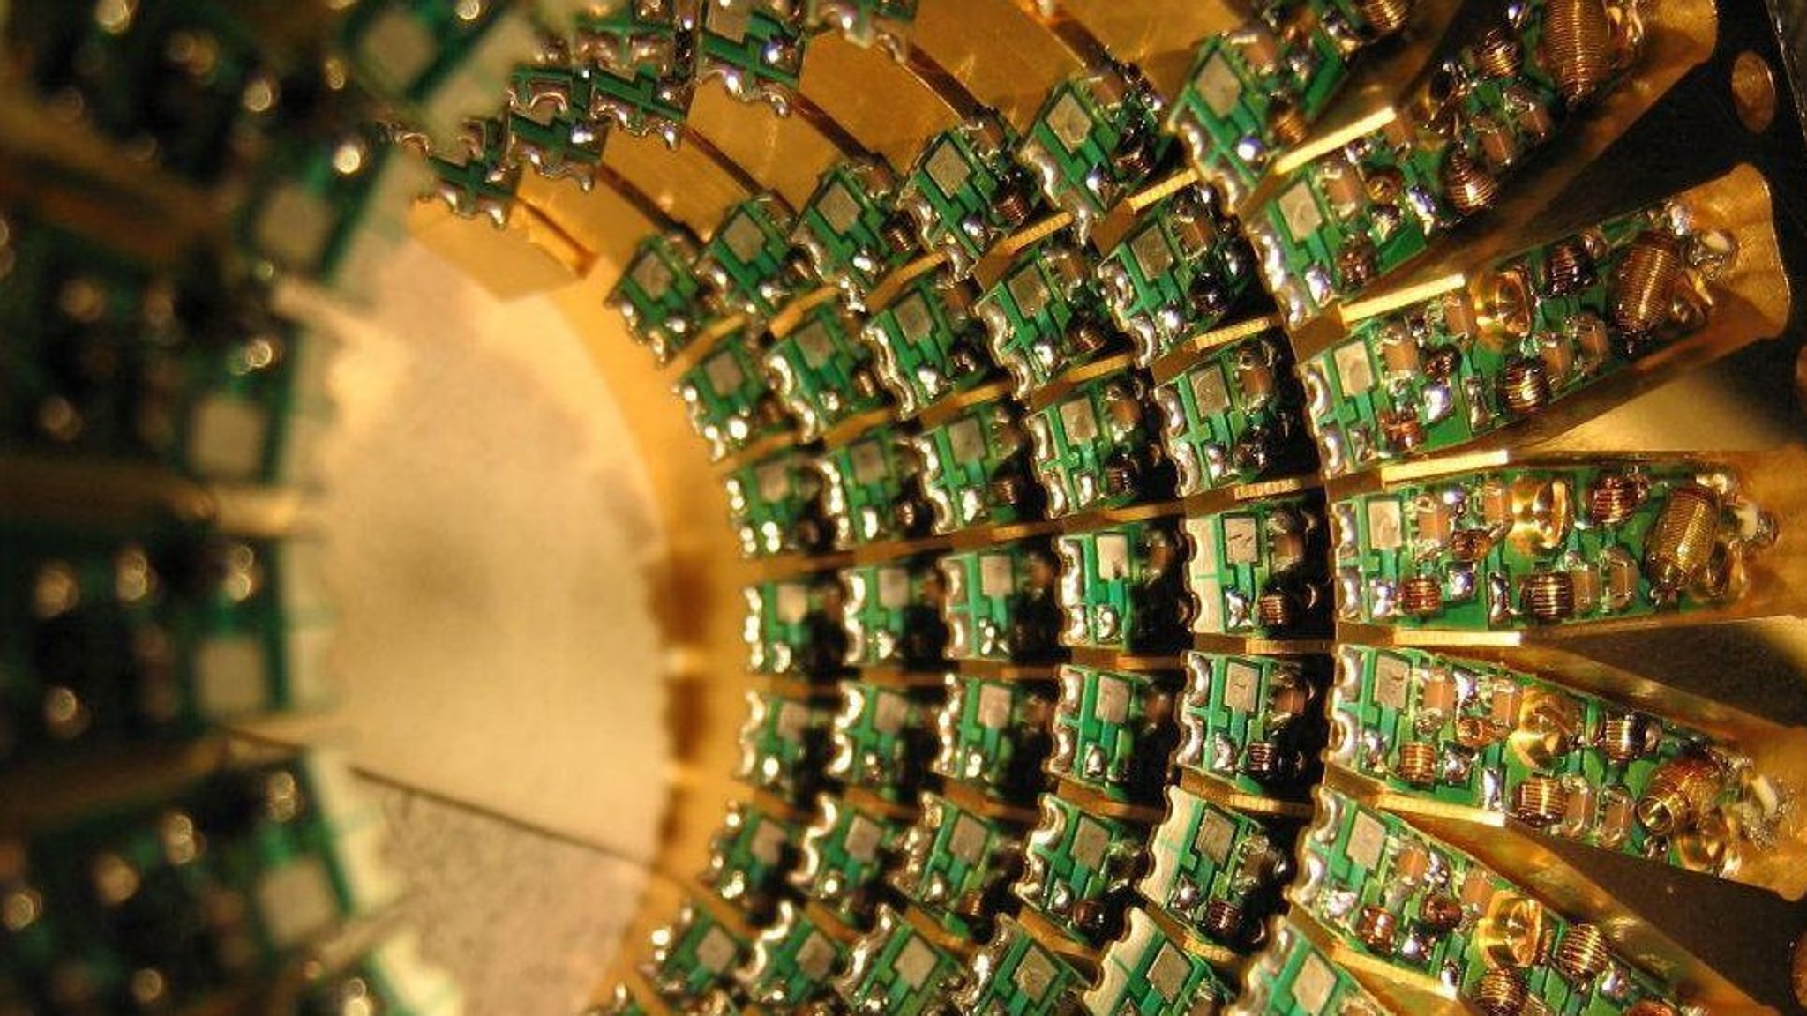
Why are quantum computers needed?
Supercomputers do not have the required memory to solve some large real world problems.
Supercomputers are slow
Notes:
10 fussy people at a dinner party, where there is only one optimal seating plan out of all the different possible combinations. Over 3 million combinations 1 week -> 1 second

Slide 6
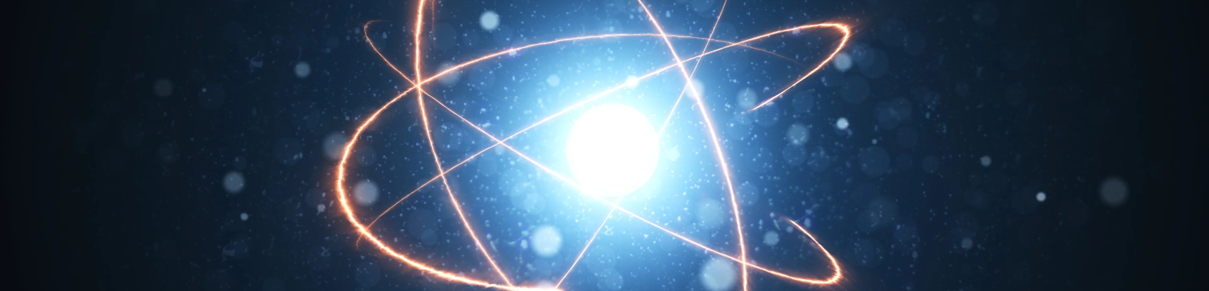
Applications
Transportation
Cybersecurity
Medicine
Artificial Intelligence and Machine Learning
Finance

Slide 7
Works Cited
“Creating the Heart of a Quantum Computer: Developing Qubits.” Energy.gov, https://www.energy.gov/science/articles/creating-heart-quantum-computer-developing-qubits.
Fisher, Chris. “Learn More about Quantum Computing Fundamentals.” q-Site, 2 Apr. 2009, www.ibm.com/quantum-computing/learn/what-is-quantum-computing/.
“Creating the Heart of a Quantum Computer: Developing Qubits.” Energy.gov, https://www.energy.gov/science/articles/creating-heart-quantum-computer-developing-qubits.

